Slide 1


School of Computing Science and Engineering
Course Code : BBS01T1002 Name:Semi Conductor Physics
Topic: Photo Voltic Effect Solar Cell
Name: Satvik Shukla (21SCSE1010146)
Saurabh sah(21SCSE1011305)
Shivam Dwivedi (21scse1010662)
Saurabh Sharma (21SCSE1010780)
Group Number:15
Section:7
Program Name:B.Tech(CSE)

Slide 2
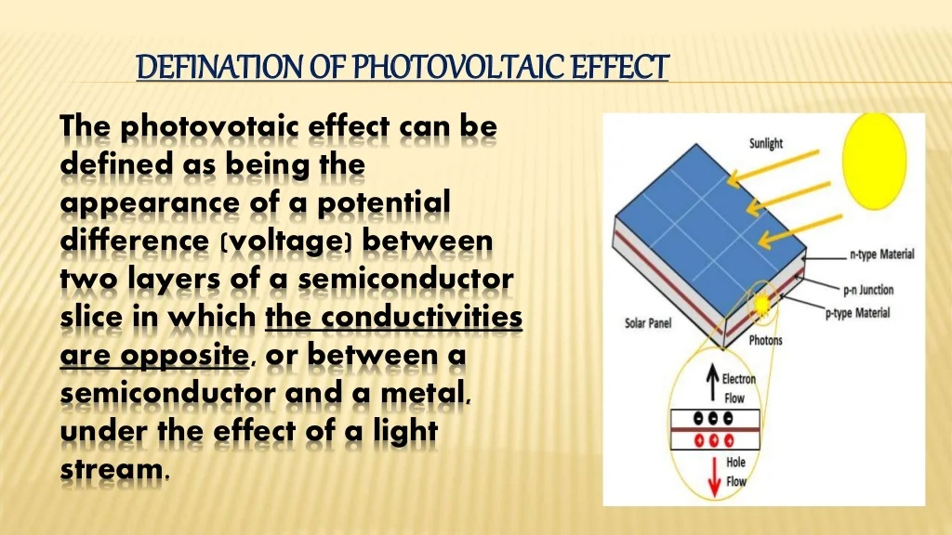

Slide 3
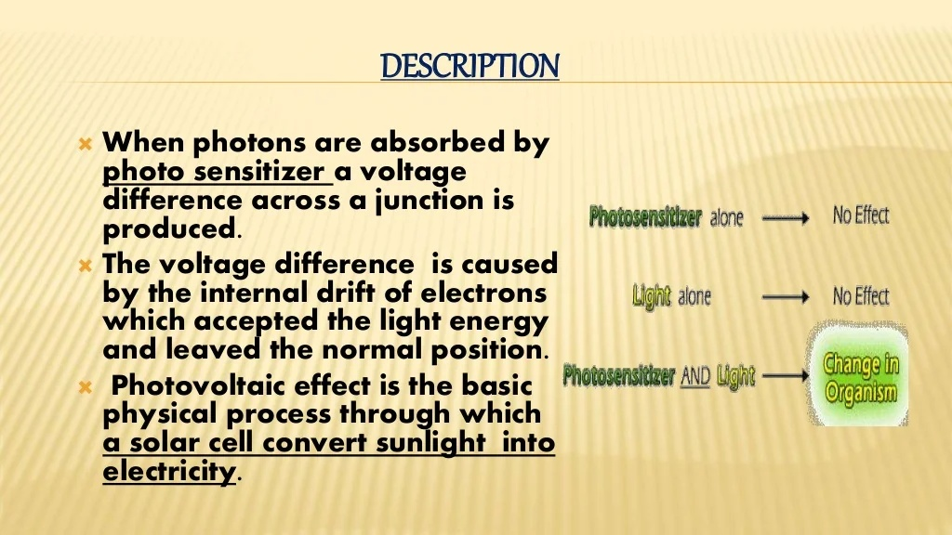

Slide 4
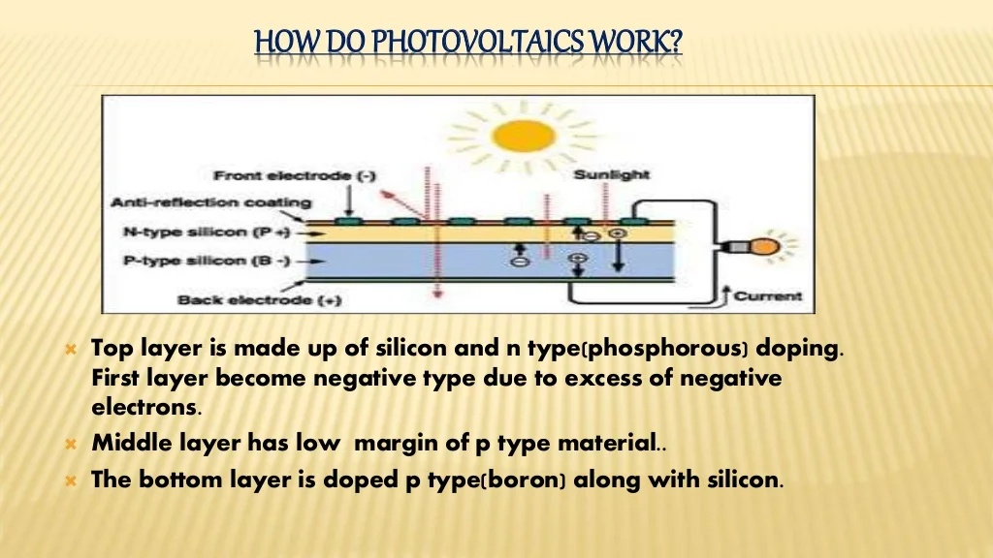

Slide 5
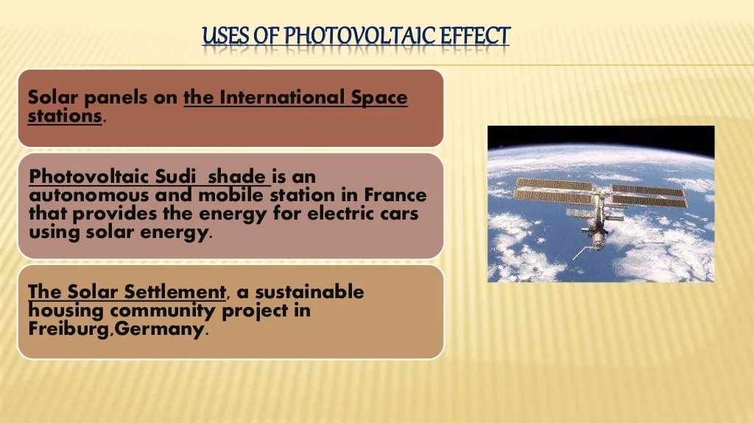

Slide 6
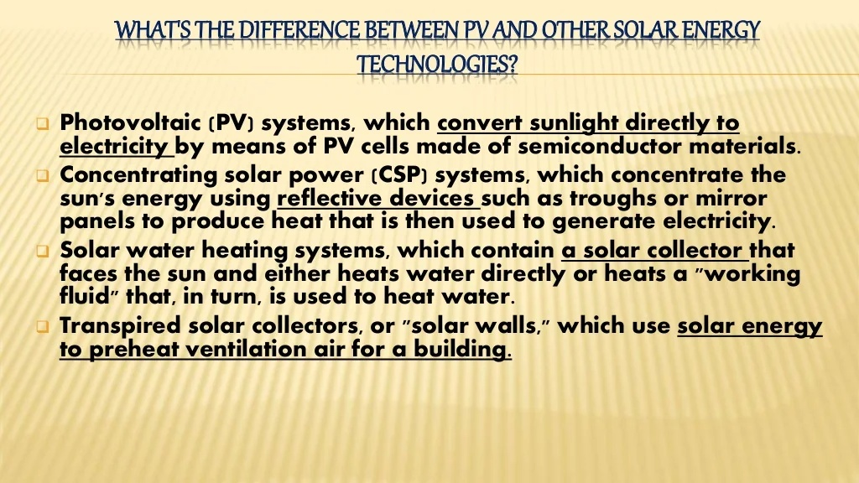

Slide 7


Slide 8
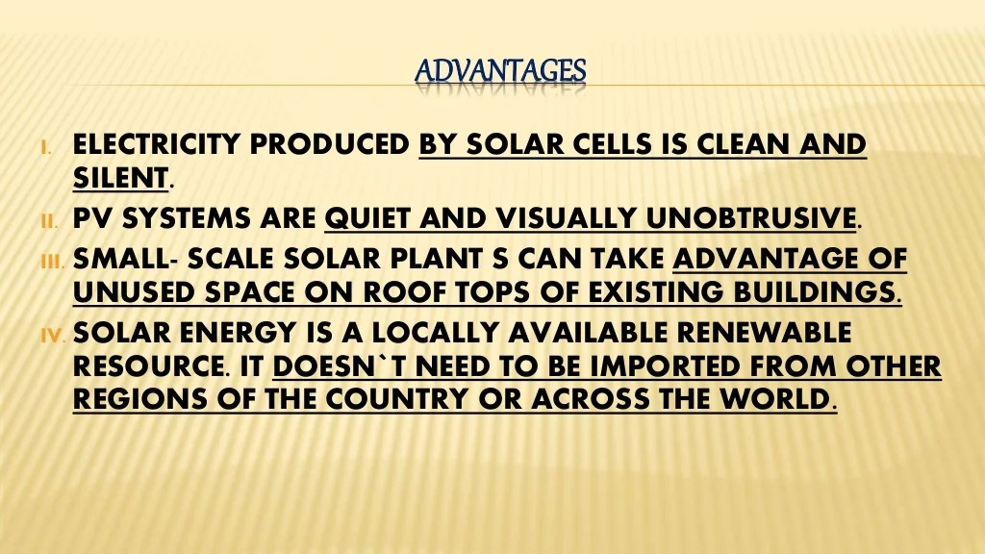

Slide 9
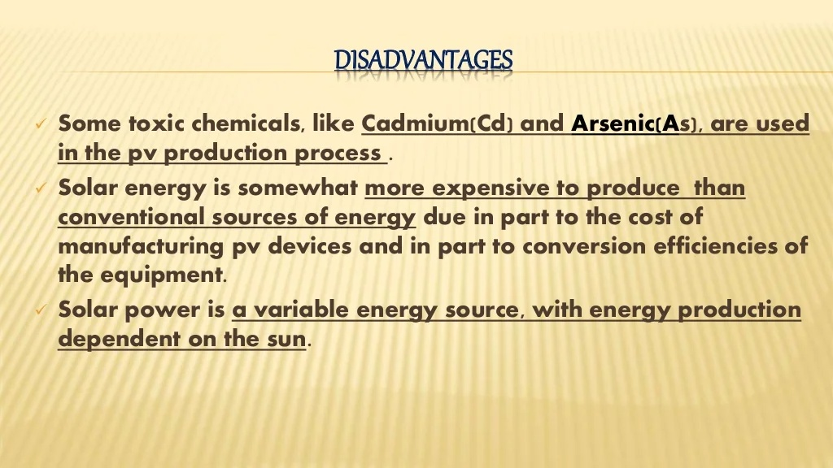

Slide 10


